Slide 1
Network Technologies
Digital Technology | Unit 1 Chapter 6

Slide 2
What is a Network?
Consists of a number of computers linked together (via cable or using wireless technology)
Allows computers to share resources including hardware and software
Computers can then communicate with each other
A standalone computer is not connected to a network.

Slide 3
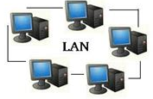
LAN and WAN?
A LAN is known as a Local Area Network
  Spread over a small geographical area (i.e. building/office).
A WAN (Wide area Network)
  Spread over a large geographical area (on a global scale)
  Requires a telecommunications link, such as fibre optic or satellite.
WAN

Slide 4

Using Networks
Users can save their work on a file server (can be retrieved from any PC on the network)
Expensive hardware can be shared
Files on the file server can be shared throughout the organisation
Backing up of data can be completed at the file server (faster and more efficient than backing up individual computers)
Security can be managed centrally.
Updates on the file server allows computers to access software quickly

Slide 5
Using Networks
When a virus is installed, it can quickly spread to all computers/organisations software
If a lot of users are using the system, can slow down dramatically
Set-up costs are high (file servers, network switches, etc)
Additional staff maybe required for maintenance/etc (increases staff costs)

Slide 6
Internet and Intranet
As well as the World Wide Web

Slide 7
Is the Internet and the World Wide Web the same?
These are separate technologies
However, they work closely together
The internet is an example of WAN (allows information to pass between computers linked to a global network) i.e. it is a method of transporting data
The WWW is an application which uses the internet

Slide 8

Website Keywords
Each Website:
Has a unique URL (Uniform Resource Location)
Uses a web authoring language such as HTML (Hypertext Markup Language)
Webpages are connected using hyperlinks, with the first page known as a Home Page
To allow websites to be accessed using the internet a communications protocol known as http (hypertext transfer protocol)
Word Selection:
URL Http hyperlinks Home Page HTML communications protocol
?
?
?
?
?
?

Slide 9
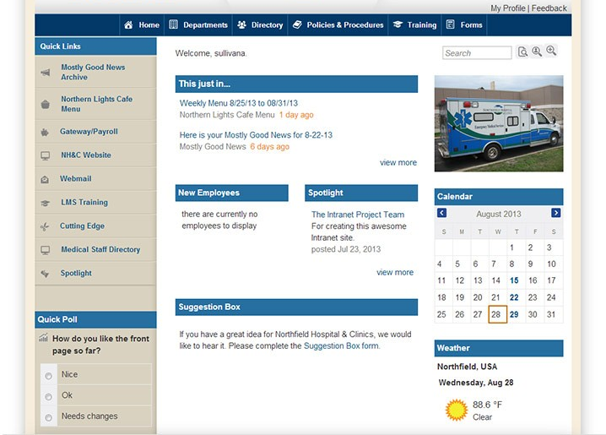
Intranet? What’s the Difference?
This is a private network owned and managed by an organisation.
Using Username/passwords, it can only be accessed by people belonging to the organisation.
In appearance, it is similar to the internet
C2K/My School network would be an example of an intranet

Slide 10
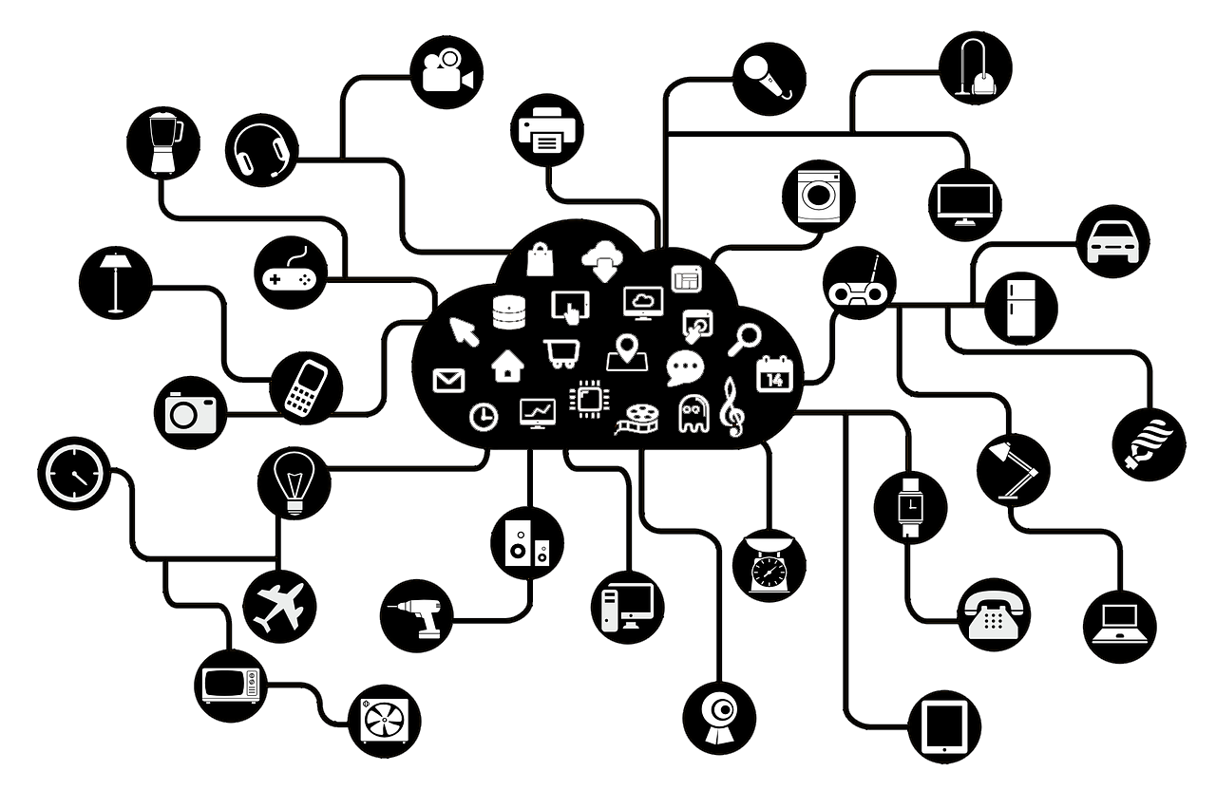
The Internet of Things
Used to describe the future impact of the
internet on how we live and work
‘Things’ embedded with circuitry and sensors with network capability which enables these objects to exchange data
Today, broadband internet access is available in more locations than ever before
Greater range of devices using WiFi technology
The scope of IoT is increasing as cost decreases

Slide 11
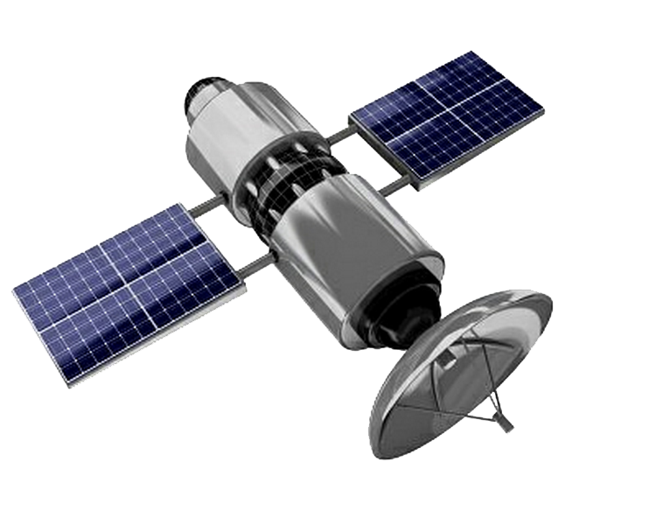
Network Communications Technology
WiFi, Bluetooth and Mobile Communications

Slide 12
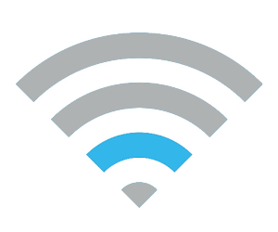
What does Wi-Fi actually stand for?
This stands for Wireless fidelity
Devices are fitted with a built in wireless adapter, allowing users to connect to a wi-fi network
Uses radio waves and a wireless router
No need for cabled connection
Often secured by a username/password
Data can be transferred up to 54Mb/s

Slide 13
Using Wifi
No need for cabling (you can be flexible and move around)
Easier to share the network amongst many users
Signal strength varies depending on how far you are from the wireless router.
Security? Unsecured wifi access means criminals don’t have to access the internals of a house – they can do so standing outside.

Slide 14

Bluetooth
Uses short range wireless technology (radio signals)
Connects two devices together, allowing data transfer
Need to be in close proximity
Have to synchronise first
No need for router, as the devices pair directly to each other
Cheap to use
Uses a lot less power than other wireless technologies
Uses include hands free phone calls and wireless mouse/keyboard

Slide 15
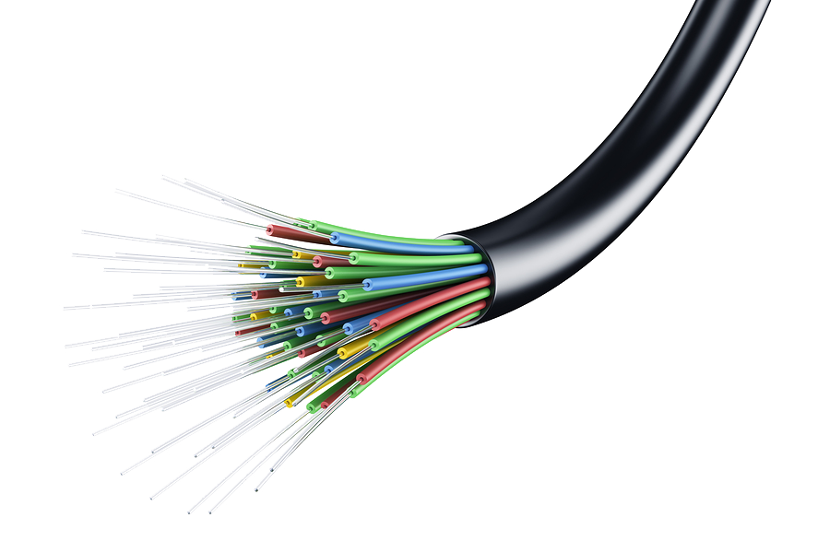
Optical Fibre
Uses very thin glass strands to send data at very fast transmission speeds
Data is transmitted as pulses of light
Each strand carries one data signal – so many strands are sending information at once
Cannot be interfered with by hackers (unlike copper cables)
Higher bandwidth so a large capacity of data can be sent at once.
Expensive to install as it requires repeaters for data to be sent over long distances.

Slide 16
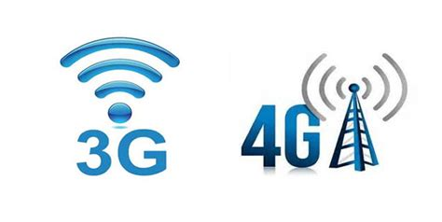
Mobile Communications Technology
2G/3G/4G (generation technology) is capable of high speed data access
Expensive set up/hardware so coverage is focused on high population areas
5G is more reliable and works across a better range and greater speed than 4G.
One drawback is that it uses a lot of battery

Slide 17
Network Resources
Cables, Switches and Routers

Slide 18
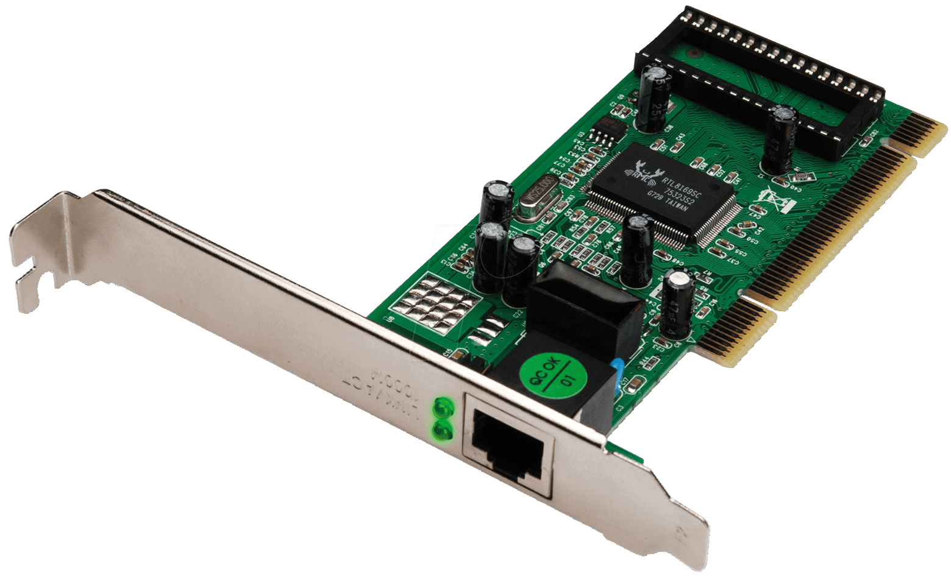
Network Interface Card (NIC)
An electric circuit board that needs to be installed in a computer
Each computer in a network requires a dedicated NIC to communicate with a file server + other computers
Provides a ‘port’ on the computer to allow it to connect to the network
Most laptops are supplied with a wireless network interface card (WNIC) as standard

Slide 19
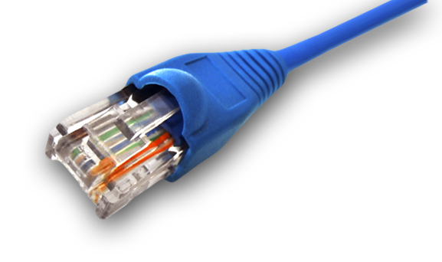
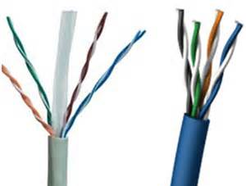
Network Cables
This is the cable that is used to directly connect into the NIC and then another device (such as switch)
Usually copper
Cables are classified into categories (depending on speed of transmission)
  i.e. CAT6 would be faster than CAT5
CAT6
CAT5

Slide 20
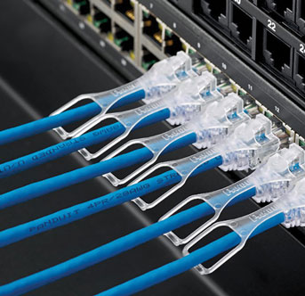
Network Switch
A hardware device which is a single connection point for computers on a network.
Allows a large number of computers to be connected
Checks the destination of data

Slide 21
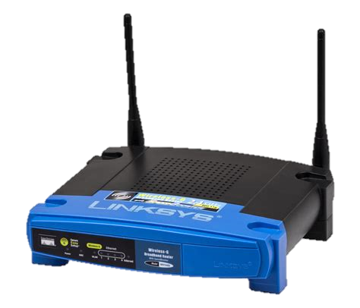
Router
Connects a number of networks together, either by cable or wireless
Examines the data as it passes and forwards it to the most appropriate route to its destination
IP addresses are used to determine the route
Some routers can filter incoming and outgoing data using a firewall feature

Slide 22
The Router Problem
This can get quite complex if the network is very large.
C●
●B
A●
But how do we get a packet (data) to computer C?
○
○
●
○
Or do we need to go this way?
○
○
Packet
So our router will decide to go from A to C
START

Slide 23
Network Topologies
Bus, Star and Ring Networks

Slide 24
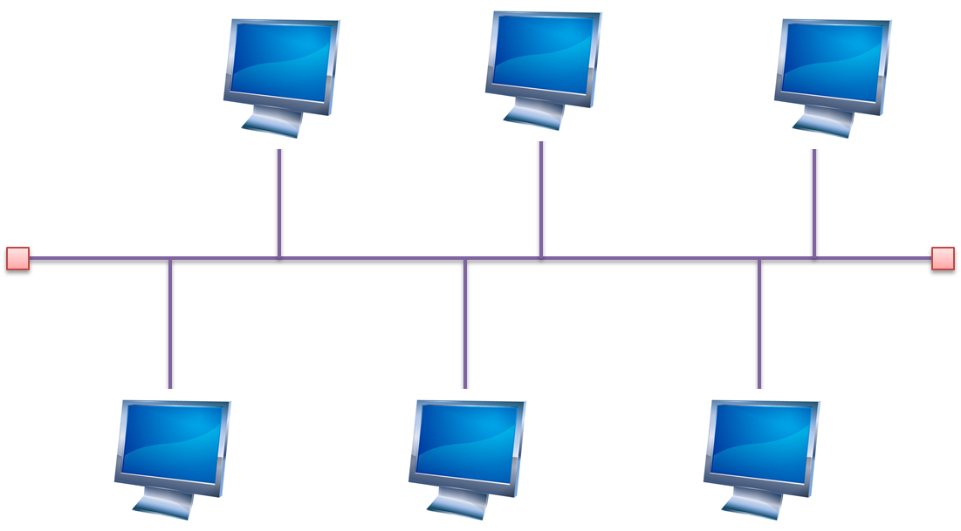
Bus Network
Computers are attached to a main cable called a backbone
Data can travel in both directions along the backbone
A new computer can be added by attaching to the backbone
Cheapest type of network
○
○

Slide 25
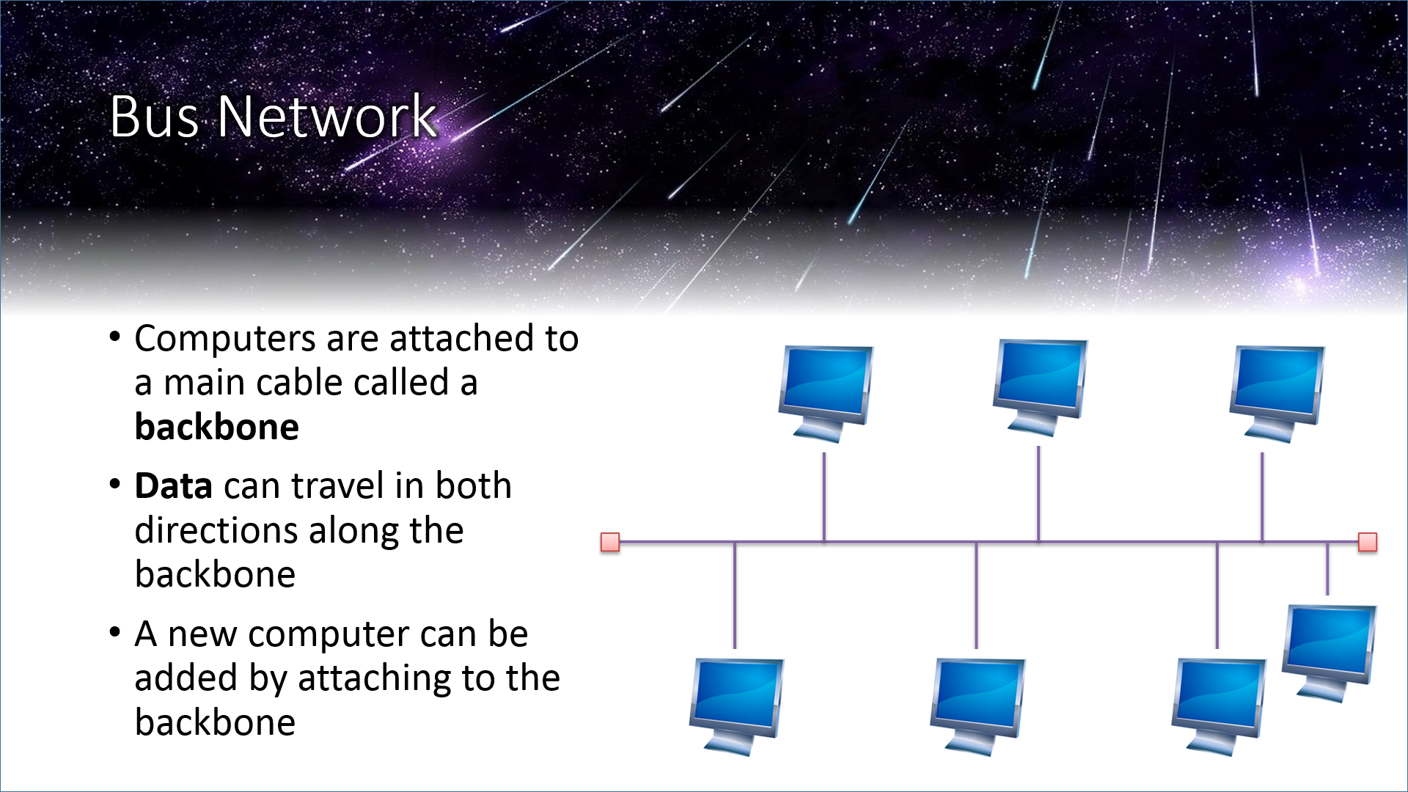
If the cable attaching to the backbone breaks,
only one computer will fail
If the backbone fails,
The whole network breaks

Slide 26

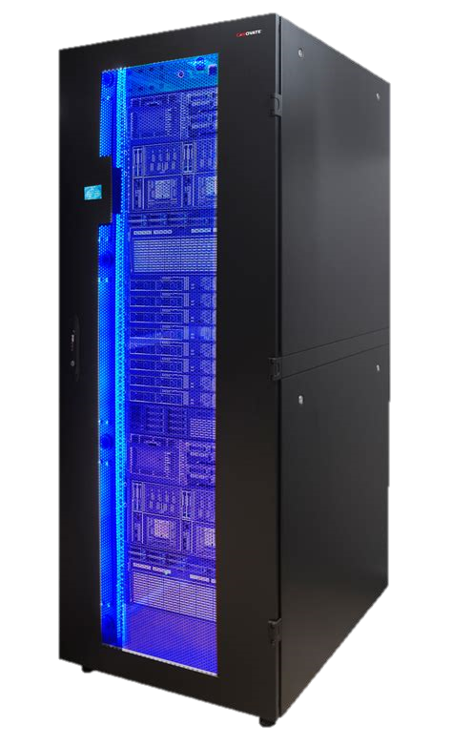
Star Network
All computers are connected to a central computer, known as a file server.
All data on the network passes through the file server
If one cable breaks, only one PC fails.
Expensive

Slide 27
Ring Network
No central/ controlling computer
Each computer is attached to two other adjacent computers.
All data travels in one direction by visiting each computer in turn until it reaches its intended destination
If a cable fails, then the whole network is affected.
To add a computer, the cables already attached need to be unattached to join the next.

